Slide 1
Stigmergy for Multi-Robot Coverage: Design Presentation
Michael Chadwick

Slide 2
Project aims
Construct a Dark Room
Small enough to fit on a table approximately one meter in diameter
Quick to set up; Quick to dismantle
Uses glow in the dark foil as flooring
Code a program to demonstrate the effectiveness of the Dark Room
Target System: e-Puck platform
Should interact with the glowing floor in some manner

Slide 3
Related Research
Products of Research
StiCo: Ranjbar-Sahraei
BeePCo / HybaCo: Caliskanelli / Broecker
Materials Research
Layering
Textured materials

Slide 4
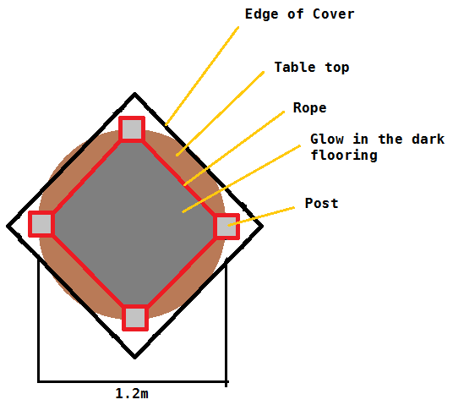
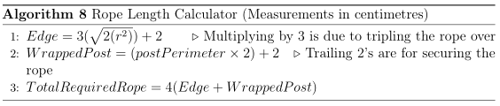
Component: Arena
Portability
4 Materials, not including table
Can fit in a Gym bag
Flexibility
Posts define arena size,
inner face
Rope adapts to posts

Slide 5
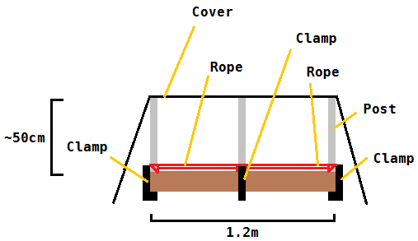
Component: Arena
Rigidity
Clamps hold the posts in place; Rope can be pulled taut
Tripling the rope provides a firm enough barrier
Sheepshank, dogshank, rope shortening knots

Slide 6
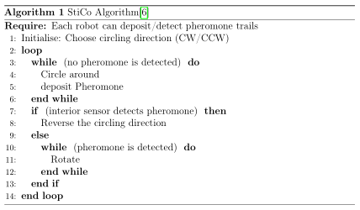
Component: Code
StiCo
Basic Stigmergic algorithm
Fulfills Project aims
Two clear states – when pheromones are detected; when none are found

Slide 7
Component: Code
BeePCo / HybaCo
Extension if time permits
Use e-Puck’s interface to decide which algorithm to run
Doubtful that range would be a problem in this project
Memory may be the deciding factor

Slide 8
Evaluation: Arena
Can it house a multi-agent system?
Can it hold robots without them leaving the area?
Will it be dark enough to not affect the testing?
Will it be bright enough to effectively evaluate the robot?
Is the setup complete within a reasonable time?

Slide 9
Evaluation: Robot
All the required functionality covered?
Interaction with localised light
Correct implementation of the Algorithm/s
Will it be efficient enough?
Coding on a new platform takes time – refactor
Any of the optional functionality covered?
Implementing a second algorithm to run alongside
Using HybaCo as a wrapper between StiCo/BeePCo

Slide 10
Human Data / Participants
No Human data will be used during the implementation stage
Human participants are unlikely
May be required later as a way to test run multiple robots together
Required steps will be taken should Human participants be implemented

Slide 11
Current Progress
Looking for materials to build the Dark Room
Wood for posts; Metal for clamps etc.
Revising C programming
Pointers
State Machines
Coding ‘Standards’
Learning how to implement e-Puck API
Stepping motions for the Motors
IR sensors
Network Connectivity (Bluetooth)

Slide 12
Thank you for your time
Any Questions?

